Slide 1
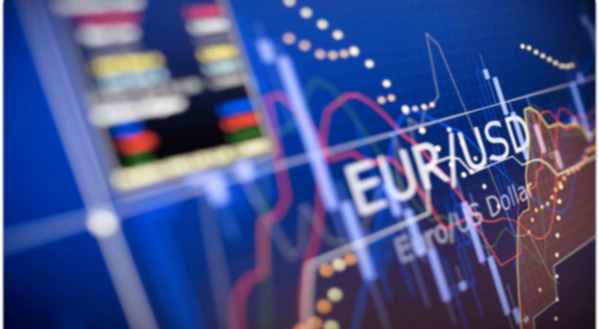
The Future of Integrity and Data Analytics in Foreign Exchange

Slide 2
FX Providers Caught Overcharging Customers
Dealers systematically and consistently overcharge clients who don’t have currency trading expertise…
Rates can be 25 times higher [for smaller corporate clients] than for bigger, more sophisticated customers.
Harald Hau,
University of Geneva School of Economics
Eva Szalay,
Financial Times
Notes:
BANKS ACCUSED OF OVERCHARGING SMALL CUSTOMERS FOR FX SERVICES Financial Times, June 16, 2019
Dr. Harald Hau, a professor at the University of Geneva, published a paper in which he discussed the Discriminatory Pricing of OTC Derivatives.
His research was based on the following hypotheses:
More sophisticated Clients incur lower transaction costs
Trades on Risk Quantifier platforms incur lower transaction costs. The effect is stronger for less sophisticated clients.

Slide 3
What is an FX Markup?
The difference between the market price of a foreign currency and the price paid by an FX client
Markups vs. Fees
The Interbank Rate
Basis Points

Slide 4
Borland Curve
*The Markup for Indifferent Client represents a 3.5% (Airport Rate) “FX” markup
220 BPs
The Borland Fair Price Markup Curve is a representative line based on actual experience
75 BPs
The shaded area represents a “Cost of Indifference”
50 BPs
30 BPs

Slide 5
How are FX Markups Determined?
Size of Transaction
Currencies Involved
Method of Trade Execution
Client Sophistication
Market Transparency
Notes:
Size of Transaction:
Smaller transactions are more likely to have high markups
Larger transactions tend to have lower markups
Currencies Involved
Developed market currencies are more likely to have lower markups
Exotic and emerging market currencies tend to have higher markups
Method of Transaction
Client/Bank communication via phone can sometimes result in higher markups and take more time than via an online platform
Client Sophistication
The level of experience, or “sophistication”, of a client can be a factor in their FX markup agreement
Market Transparency
As the market becomes more transparent, it is projected FX markups will come down

Slide 6
Reviewing FX Costs
Consistent, lower FX costs
TRANSPARENCY
(BACKTESTING & BENCHMARKING)
NEGOTIATING
AUDITING
Notes:
Transparency of the market and financial institutions
Bank negotiations and agreements
Consistent auditing

Slide 7
Who Benefits From an FX Rate Review?
Companies who use a multi-bank competitive
bid structure
“Indifferent” Clients
Global Subsidiaries

Slide 8
CASE STUDIES

Slide 9
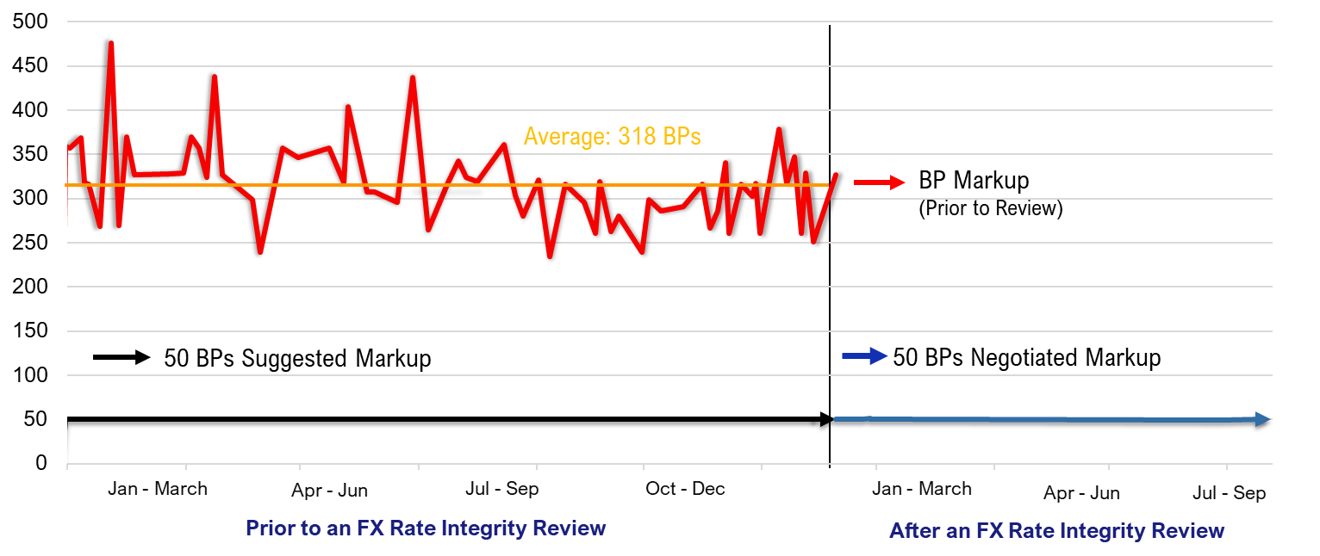
Case 1a: Lower FX Markups – Mid-Market
Prior to a Foreign Exchange Rate Integrity® Review
After a Foreign Exchange Rate Integrity® Review
FOOTNOTES:
A Foreign Exchange Rate Integrity® Review found markups at 318 BPs and excess FX costs of more than $54,000/year.
Data Analytics and Coaching led to a lower markup agreement at 50 BP.
Given this new agreement, the Middle Market Company’s FX costs reduced to approximately $10,000/year on a $2,000,000 annual FX flow.
Notes:
A Middle Market Client was unknowingly paying an Excessive FX Markup along with modest FX fees. It is typical for Middle Market companies to be subject to excessively high markups. As in this case, Middle Market companies can pay markups as high as 476 BPs—this case proved a more appropriate markup is around 50 BPs.

Slide 10
Case 1b: FX Markup Mistake – An Algorithm Issue
Increased BP Markup
BP Markup
(Within Negotiated Agreement)
“Off the Grid”
&
“Excessive Markups” *
March 1
* For 6 “Off the Grid” trades, the client incurred “Excessive FX Markup Costs” of approximately $7,000
March 30
FOOTNOTES:
A middle market client was subject to their FX Provider going “off the grid” and back to high markups over 200 BPs. As a result of an error on the Providers’ behalf, the client incurred “Excessive FX Costs”.
The error went “unnoticed” for over a month until a Foreign Exchange Rate Integrity® review highlighted the mistake.
The FX Provider revised the client’s pricing algorithm and went back to 50 BPs, as agreed.
Notes:
The middle market client was subject to the bank going off the “grid” and back to high markups from over 300 BPs, the client again incurred “Excessive FX Costs” as a result of an error, by the bank, in their FX pricing algorithm. This error went “unnoticed” for over a month until an external FX Rate Review highlighted the mistake. The bank then revised the client’s pricing algorithm and went back to 50 BPs.

Slide 11
Case 2: 95% FX Markup Cost Savings
USD Markup (Based on Negotiated Agreement)
USD Markup (based on historic markup)
Approx. $58,500 in savings
Gross Savings (in USD)
Approx. $43,000 in savings
Approx. $40,000 in savings
Approx. $31,000 in savings
1st Q
2nd Q
3rd Q
FOOTNOTES:
This chart reflects a corporate client receiving a regular flow of Euros and doing FX window forwards to hedge them in US Dollars. This demonstrates the results of newly negotiated FX Markups
The new FX Markup of 3 BPs (shown in USD by the blue bar) is a significant improvement from the client’s previous markup of 67 BPs (shown in USD by the red bar). The green area reflects the large savings for each quarter, due to the newly negotiated markup agreement.
Notes:
An initial FX Rate Integrity Review showed the client would benefit from a competitive ”grid pricing” model. A structured grid is appropriate for larger FX Flows with both large and smaller FX transactions.’
Based on a competitive Request For Proposals, one of the relationship banks won the FX Flow at a much lower cost.
The grid was “structured” such that FX trades up to $1 million only had markups of 20 BPs and it dropped to only 3 BPs for transactions over $1 million.
It was one of the client’s Regional Banks that was hungry for ancillary business that bid at only 3 BPs compared to where they had been paying on average 67 BPs.
The new FX arrangement reflects a 95% cost reduction.
The chart reflects a Corporate Client receiving a regular flow of Euros and doing FX window forwards to hedge them in US Dollars.
The graph, which we call the “Christmas Tree Chart”, demonstrates the results of the newly negotiated FX Markups.
The small Blue Bar is the cost of the new FX Markup (3 BPs), while the Red Bar reflects what the prior 67 BPs Markup would have cost for each quarter. The Green Bar reflects the large savings for each quarter.
This is the “Christmas Tree Chart” due to the heavy Red and Green, and because it was like a Christmas gift to the client!

Slide 12
Case 3: Two Significant FX Arrangements
Bank 1 (With FXRI® Negotiated Agreement)
Bank 1 (Pre-FXRI®)
Bank 2 (With FXRI® Negotiated Agreement)
Bank 2 (Pre-FXRI®)
Average BP Markup (for Bank 1 & 2)
FOOTNOTES:
This Global Company was managing their FX activity through two FX Provider. With Foreign Exchange Rate Integrity®, the Global Company was able to get a 69 BPs reduction (for Bank 1) and an 18 BPs reduction (for Bank 2), resulting in two new FX Bank Arrangements at 10 BPs each.
The combined annual flow (across all their subsidiaries) was over $60M, with a total save of approximately $700,000.
It is notable that in the second month of the 1st quarter review, ”Bank 2” charged 0 BPs for FX transactions, while Bank 2 similarly maintained the agreement to remain below 10 BPs.
Notes:
Global Company was able to get a 69 BP reduction and an 18 BP reduction, resulting in two new FX Bank Arrangements with their existing banks at 10 BPs each. The combined annual flow (across all their subsidiaries) was over $60M, with a total save of approximately $700,000.
It is notable that the Global Company was able to negotiate this fair FX Markup Agreement across all their subsidiaries.

Slide 13
In Summary
We see FX Markups going lower, influenced by the following factors:
Competition for FX Flows
Technology
Data Analytics
Robotic Process Automation
It won’t be overnight but, with further Technology and Competition, the trends will continue to drive down FX Costs. The FX market is still very inefficient, in terms of price transparency, for both Corporate and Commercial clients.

Slide 14
https://www.bladesintl.com/
blades-international-inc
https://bladesintl.wordpress.com/
Blades International, Inc

